Slide 1
Software Engineering
Lesson 1 – Different Ways of Presenting Requirements
LO2 : Carry out a requirements acquisition exercise in order to identify the main functional and non-functional requirements of a proposed software system

Slide 2
Lesson Objectives
Understanding the Different Ways of Presenting Requirements.
Formal Documentation
Semi-Formal Documentation
Informal Documentation
Best Practices for Documenting
Functional Requirements
Non Functional Requirements
Specifying Requirements for Agile Development
User Stories
Epics

Slide 3
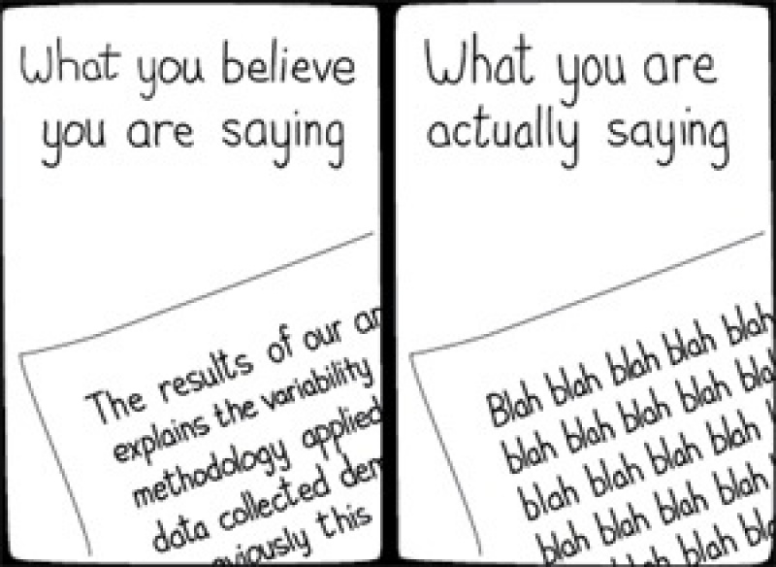
Ways of Presenting Requirements
Requirements specify WHAT the SYSTEM should DO.
Getting requirements specified in the clearest way possible is of vital importance to the success of the system – get the wrong requirements and you develop the wrong system!
To ensure that requirements are specified in a way which is understood by everyone – clients, end users and developers alike – usually requirements are presented using a combination of the following 3 methods:
Formal Specification
Semi Formal Specification
Informal Specification

Slide 4
Ways of Presenting Requirements
Formal Specification
Uses Mathematical Notation to specify exactly what we need. These leave very little room for ambiguity and misinterpretations but are often hard to understand.
Semiformal Specification
Natural Language with diagrams and tables. This might include Data Flow Diagrams, ERDs, UML Diagrams, etc. If used properly, this can be a very effective way of communicating clear, consistent requirements.
Informal Specification
Written in Natural Language (English) as carefully as possible. Natural Language may be inadequate to write precise, consistent and unambiguous specifications as they leave room for different interpretations.

Slide 5

Ways of Presenting Requirements
Requirement Specifications are usually documented in a vital piece of documentation known as the Software Requirement Specification Document (SRS).
A very common approach to creating Requirements Specification Documentations is to create one informal document for the users and one (semi)formal document for the developers.
It is important, however, to ensure that these are consistent with each other and that the meaning of each requirement is the same in both documents!
Also, all stakeholders – clients and development team alike
must be in full agreement about these requirements and their
meaning as they represent what the new system will do/achieve
and what developers will program!

Slide 6
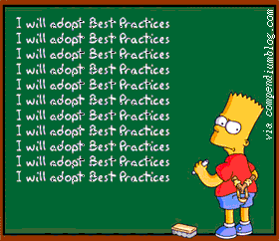
Best Practises for Specifying Requirements
Requirements Specification Documents should always:
Specify Functionality without going into Implementation Details.
Develop a Model of the System Behaviour.
Develop a Model for Data / Paperwork/Settings of the System.
Establish the System Context
Establish any Environments that Interact with
the System.
Allow for modifications, new additions and
incomplete requirements.

Slide 7
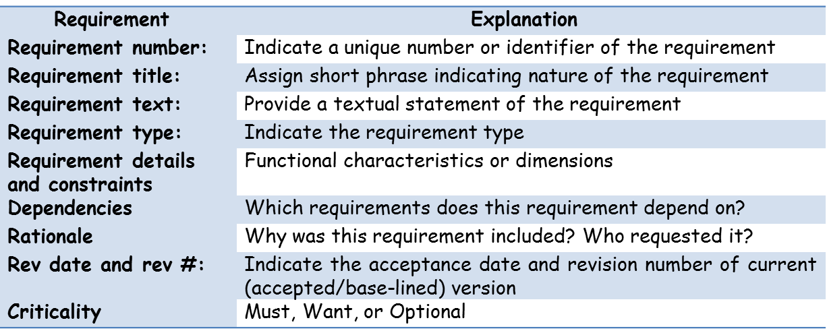
Best Practises for Specifying Requirements
In order to make sure that all necessary details have been included in a requirement specification, the following information is usually recorded for every requirement.
Many Project Management Systems have built-in templates which will allow you to document all/most of these details for each requirement created.
Notes:
Note :

Slide 8
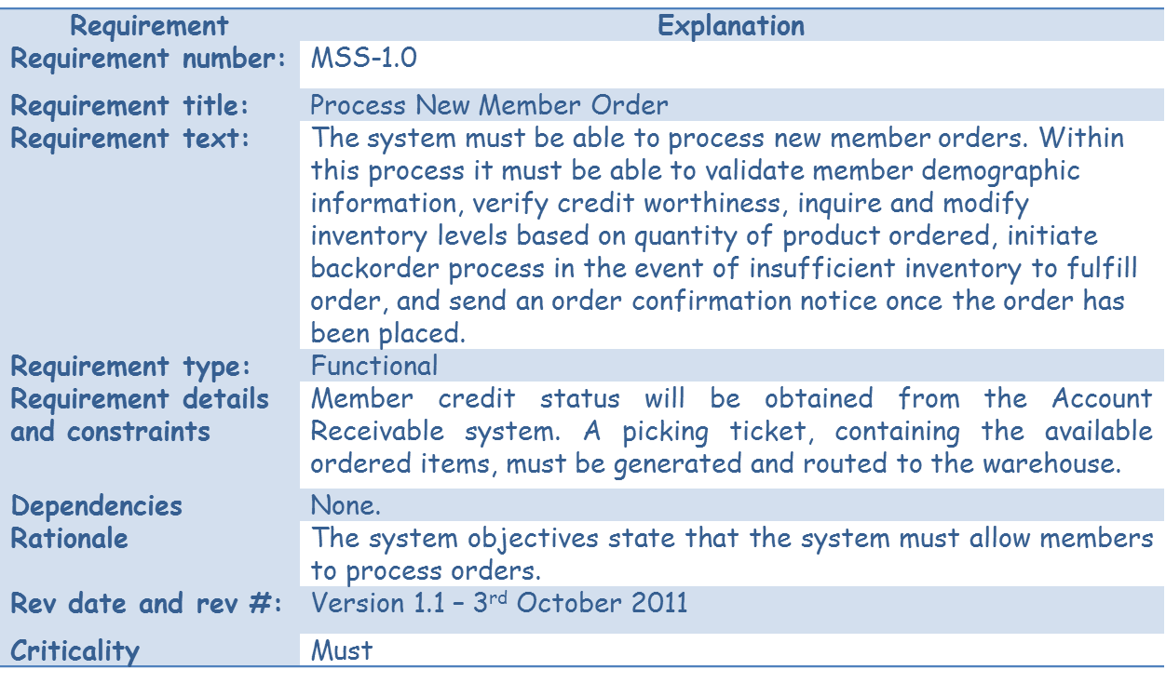
Best Practises for Specifying Requirements
Specifying Functional Requirements
An Example….
Notes:
Note :

Slide 9
Best Practises for Specifying Requirements
Specifying Non - Functional Requirements
Take a Look at the following Specification …….
Is this specification adequate enough?
What problems could arise due to inadequately specified requirements?
What can be done to improve it?
Notes:
Note :

Slide 10
Best Practises for Specifying Requirements
Specifying Non - Functional Requirements
In order to specify Non-Functional Requirements correctly, these should be written using some form of quantification so that they can be tested “objectively”
Notes:
Note :

Slide 11
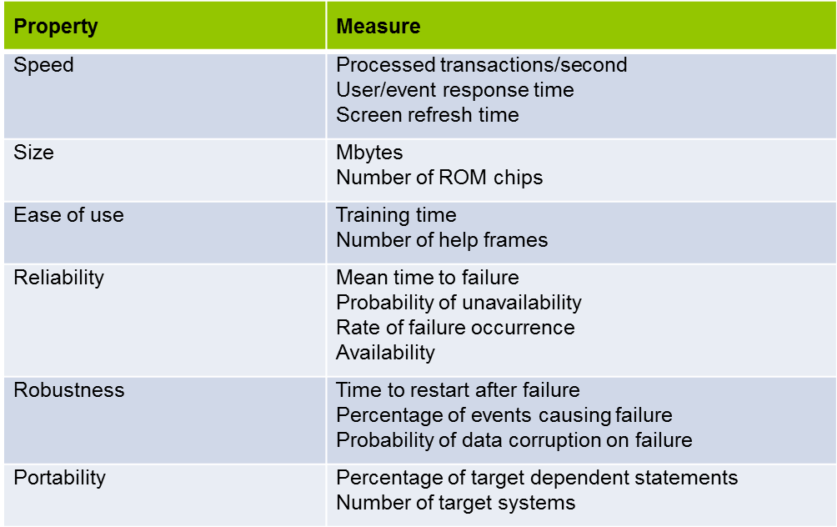
Best Practises for Specifying Requirements
Specifying Non - Functional Requirements
Ways of Quantifying Different Non-Functional Requirements

Slide 12
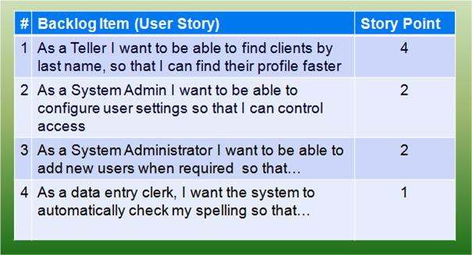
Specifying Requirements for Agile Development
In Agile Development, requirements are specified in a different way to :
Put more focus on the individuals rather then the system
(Core Value No 1 : Individuals vs Processes)
Emphasize more on the actual system to be produced rather than paper work
(Core Value No 2 :Working Software vs Documentation)
Requirements are specified as User Stories in the Product Backlog

Slide 13
Specifying Requirements for Agile Development
What are User Stories?
User Stories include a written sentence or two and, based on a series of conversations between all team members, about a desired functionality.
This approach helps shift the focus from writing about requirements to talking about them.
(Core Value No 3 : Collaboration vs Negotiation)

Slide 14
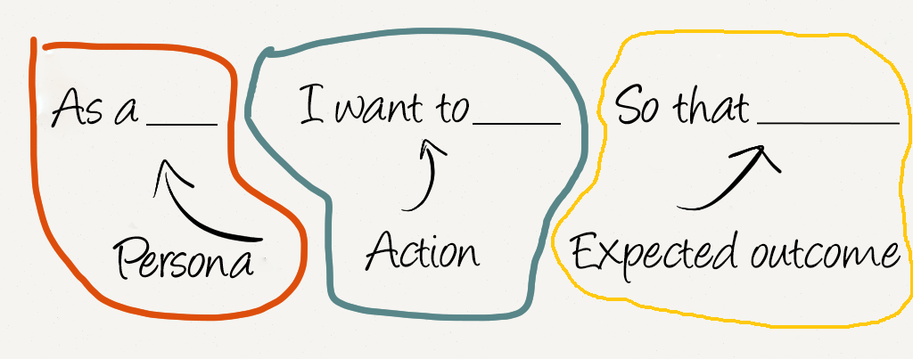
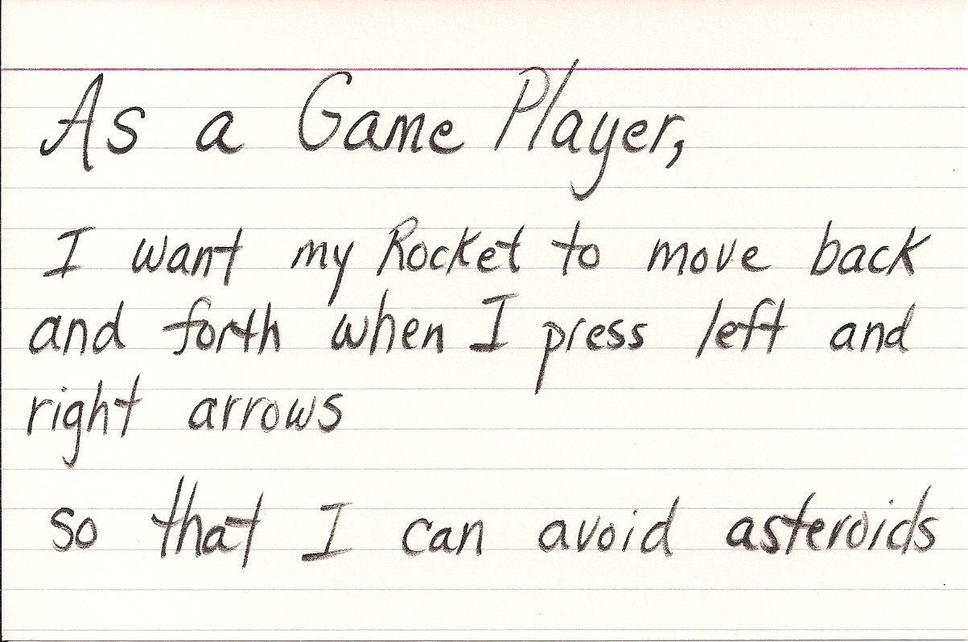
Specifying Requirements for Agile Development
How Should a Good User Story be written?
A User story should be :
1. Short
2. Simple
3. From the perspective of the person who desires the new capability.

Slide 15
Specifying Requirements for Agile Development
Epics Vs Stories
Some user stories may cover large amounts of functionality making them:
Complex to understand and develop
Too Large to complete in 1 iteration
These large user stories are generally known as EPICS.

Slide 16

Specifying Requirements for Agile Development
Epics Vs Stories
Epics need to be split into multiple smaller user stories to:
Make them simpler to understand
Easier to develop by adding more detail to each specific story
Reduce risk of oversights e.g. missing out functionality

Slide 17
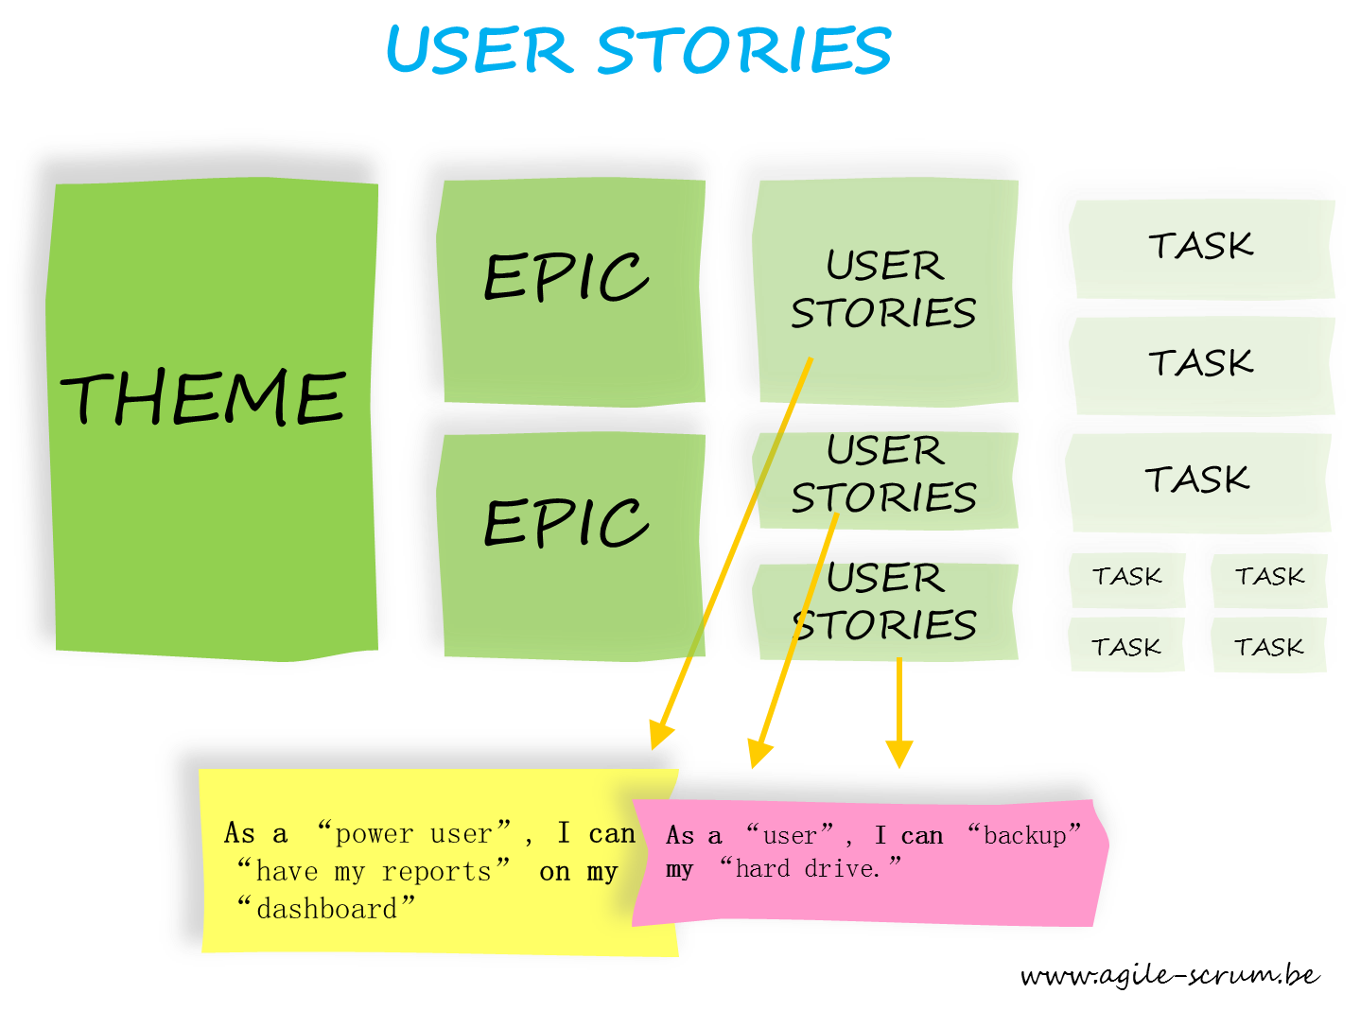
Specifying Requirements for Agile Development
Notes:
Large epics are known as Themes
User stories can be further split into tasks

Slide 18
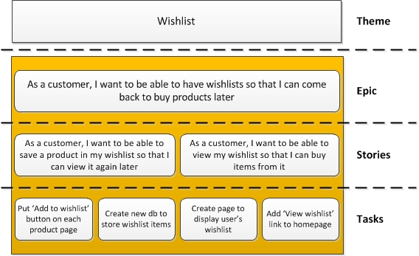
Specifying Requirements for Agile Development

Slide 19
Specifying Requirements for Agile Development
Class Exercise : Reword the following requirements as user stories
The system must allow new users to register a new email account by entering their username, password, personal details, security question and answer, alternate email address.
The system must allow existing users to log in to their account by supplying a correct username and password
The system should allow users to recover their password by sending a new password to their alternate email address if the security question is answered correctly.
The system must allow users to manage their emails i.e. compose, view, send, receive, forward, save to drafts, archeive.

Slide 20
End of Lesson 1
Any questions?

